Slide 1

Exoskeleton
Master and Node Assembly Enclosure Design
Prototype Lab, Groundswell Startups
Date: 03-04-2026, Version: 1.1

Slide 2
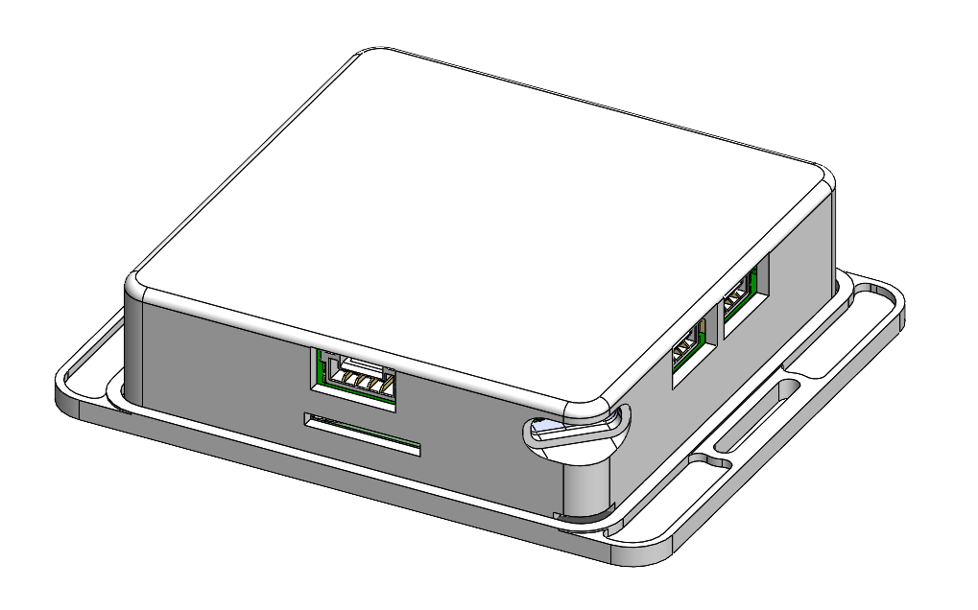
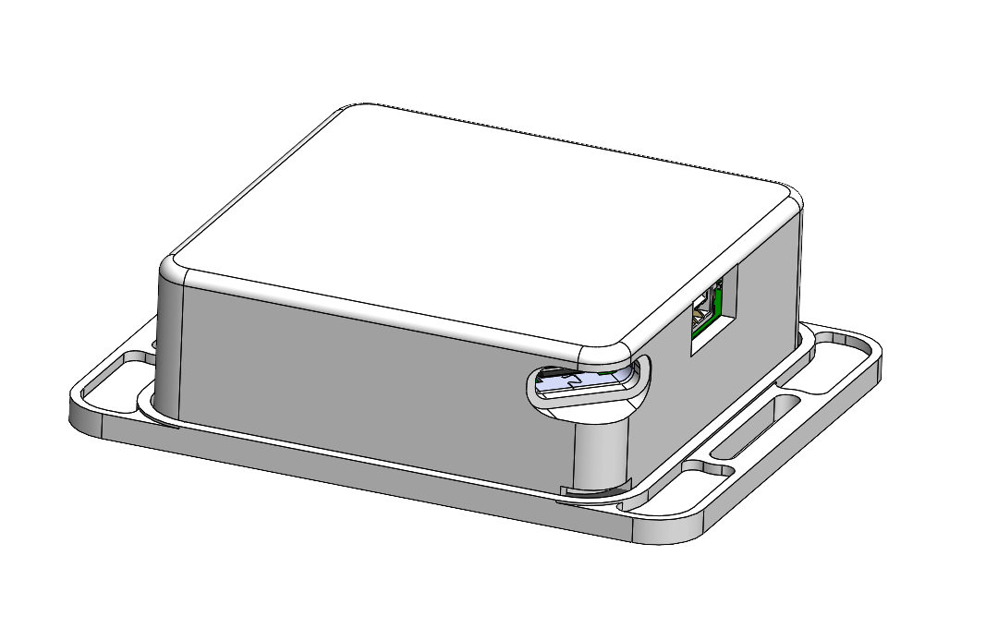
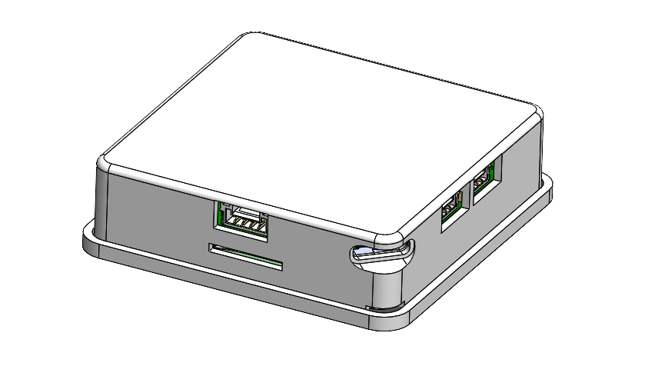
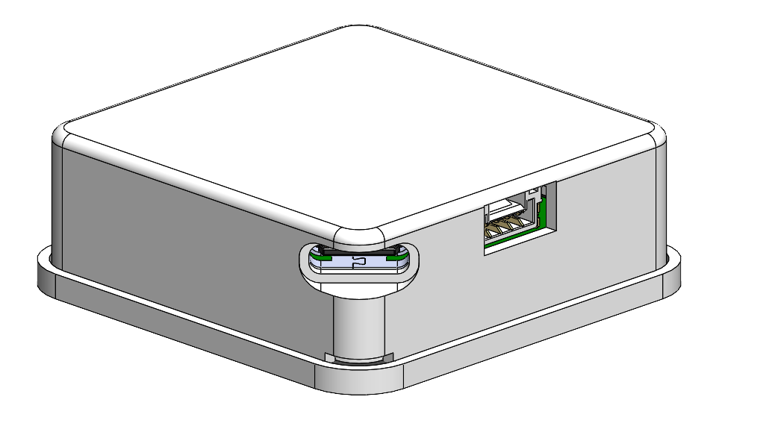
Master PCB Assembly with encloser
Node PCB Assembly with encloser

Slide 3
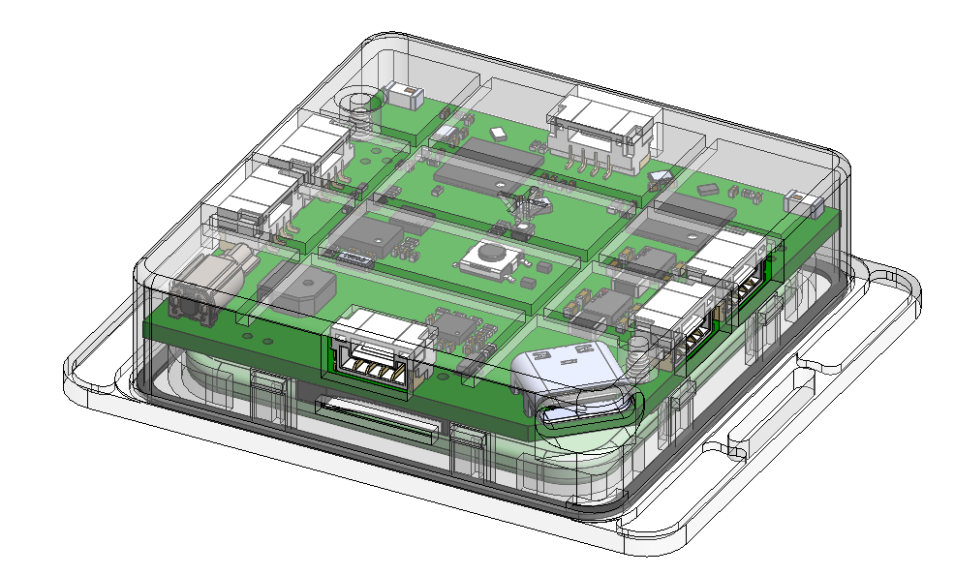
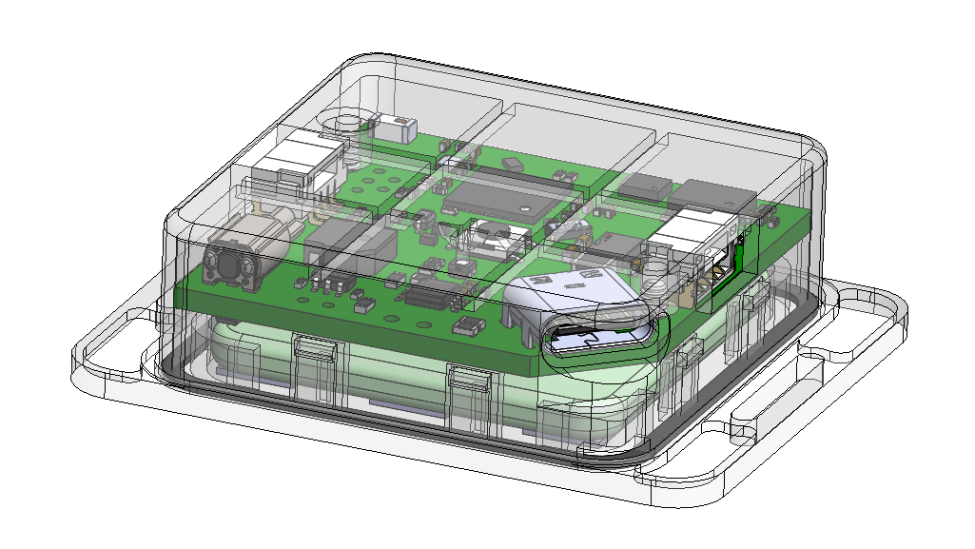
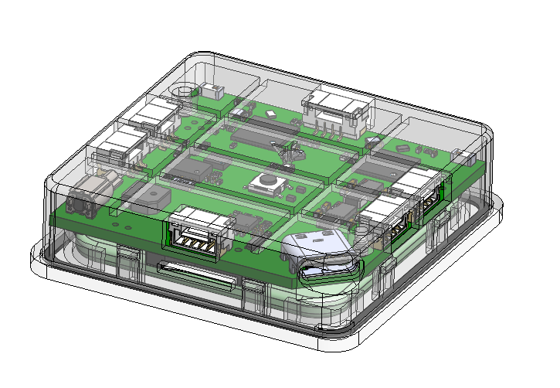
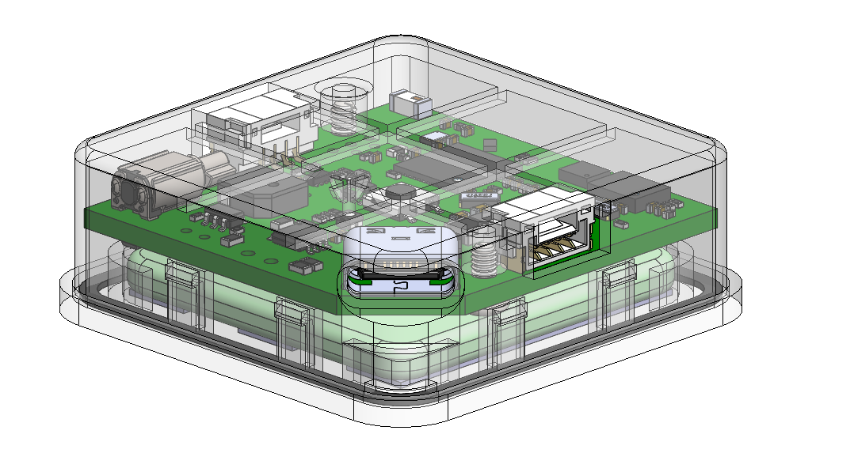
Master PCB Assembly with encloser
Node PCB Assembly with encloser

Slide 4
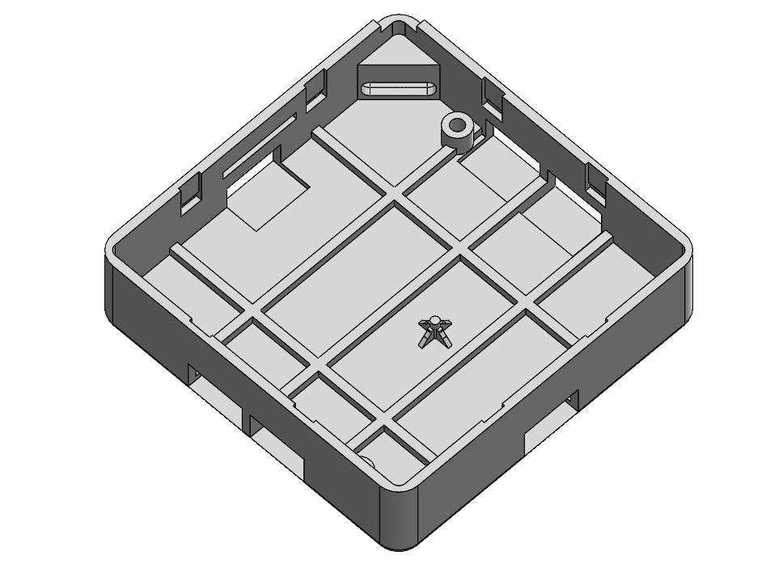
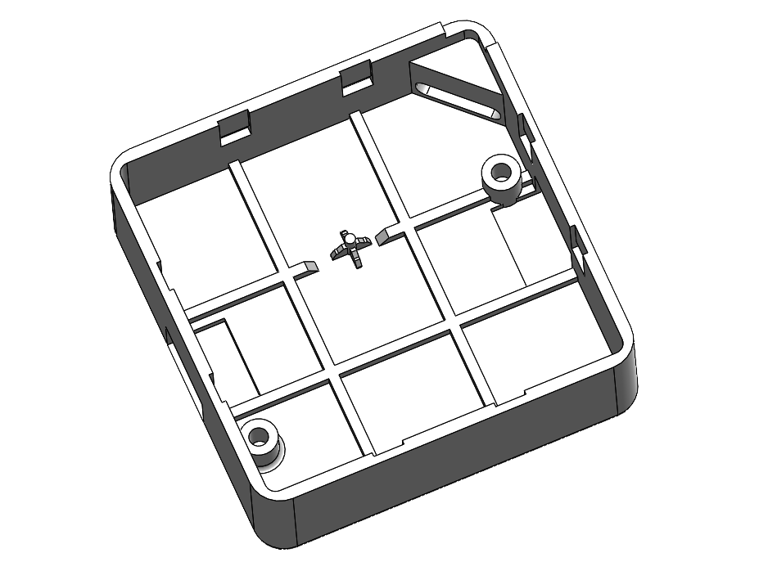
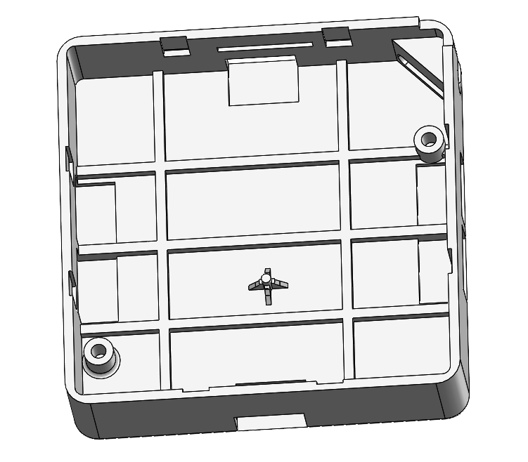
Master PCB Assembly Top Part
Node PCB Assembly Top Part

Slide 5
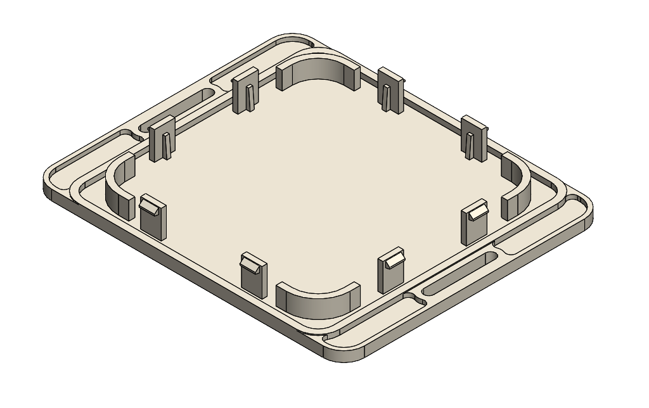
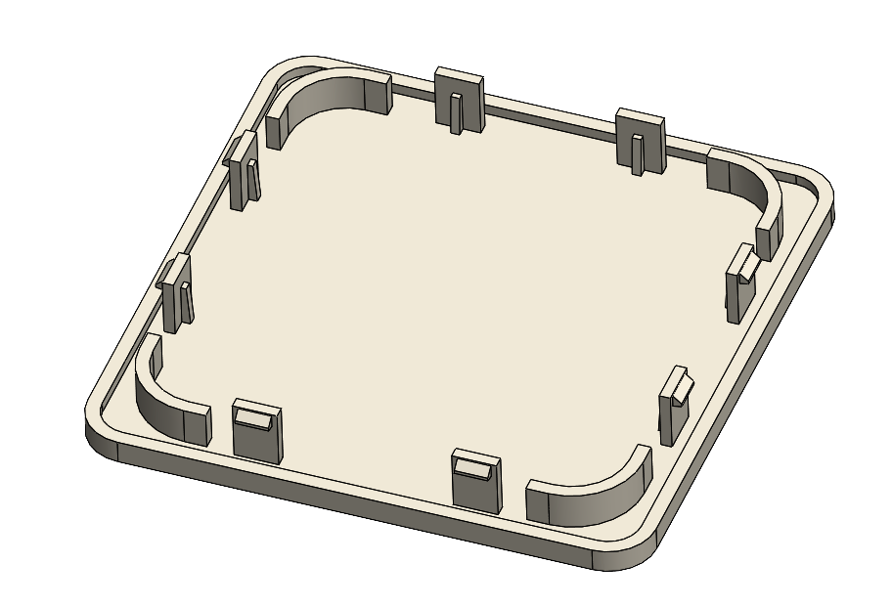
Master PCB Assembly Bottom Part
Node PCB Assembly Bottom Part

Slide 6
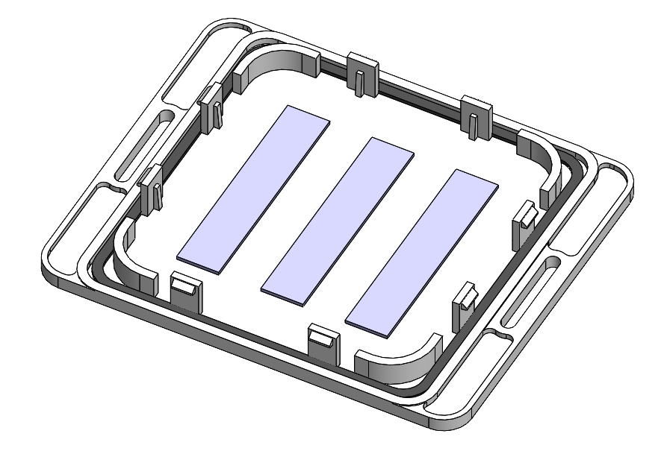
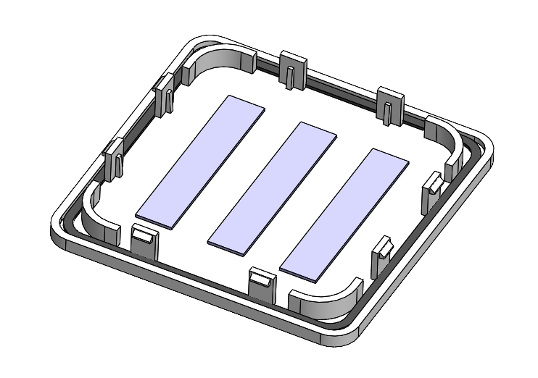
Node Bottom Part with DST for Battery
Master Bottom Part with DST for Battery

Slide 7
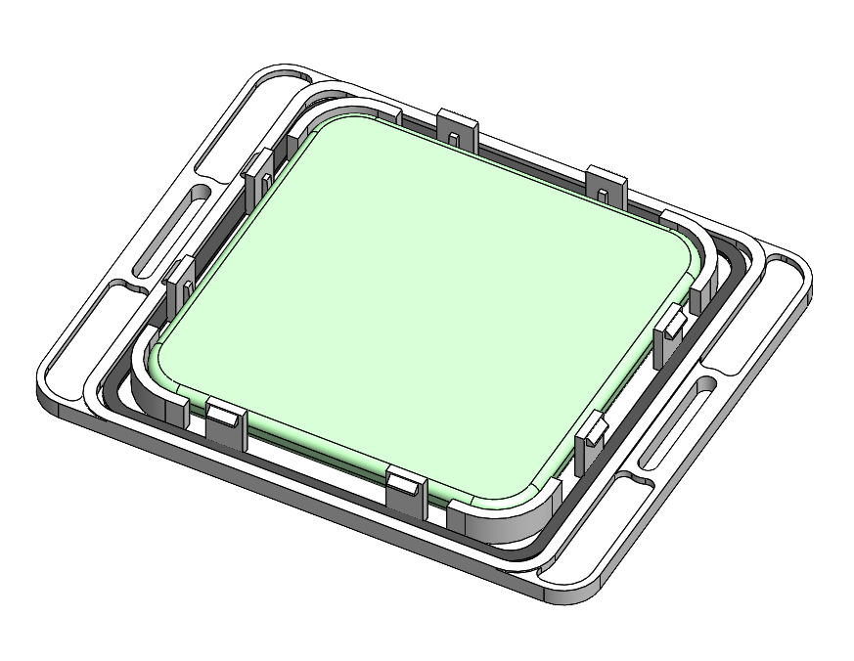
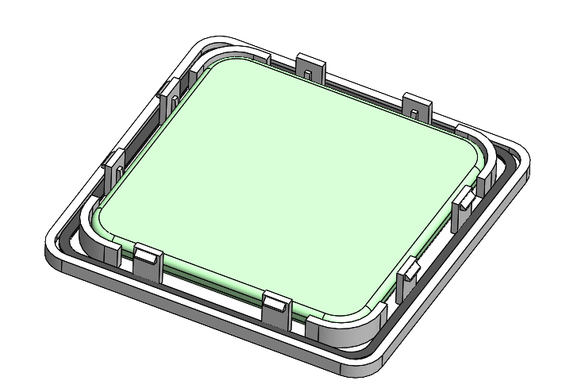
Node Bottom Part with DST & Battery placement
Master Bottom Part with DST & Battery placement

Slide 8
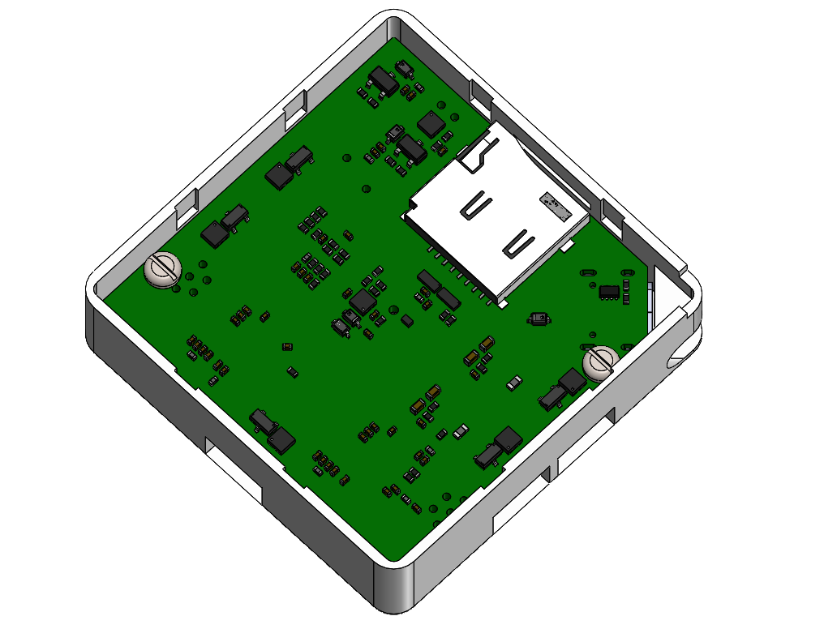
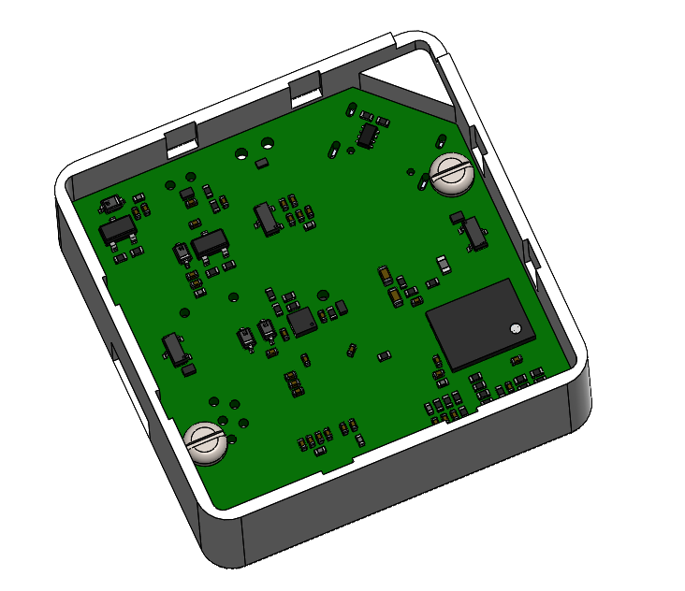
Master Top Part with PCB placement with self tapping screw
Node Top Part with PCB placement with self tapping screw

Slide 9
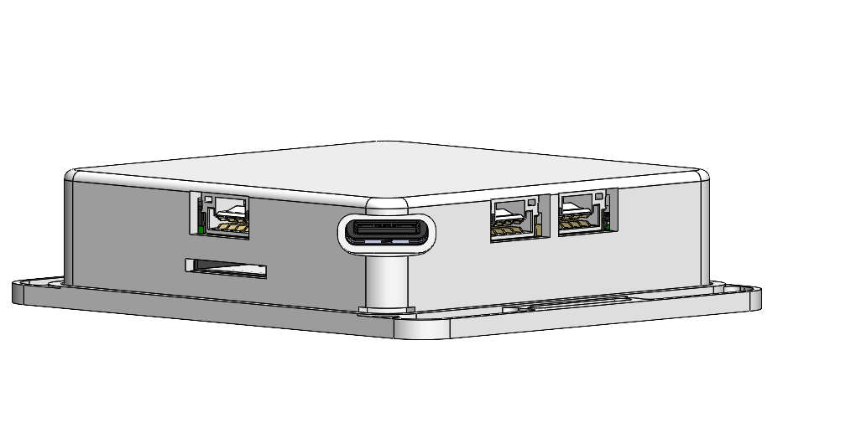
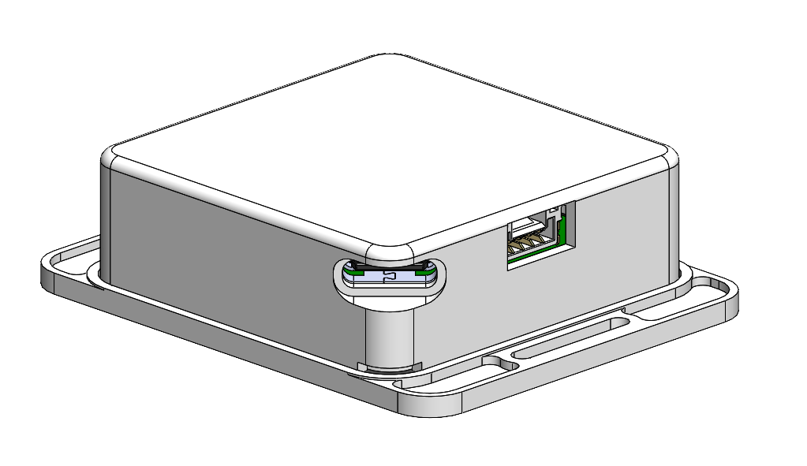
Master Top Part with cutout for USB-C
Node Top Part with cutout for USB-C

Slide 10

Length – 42mm Width – 42mm
Thickness – 3mm
Length – 32mm Width – 32mm
Thickness – 3mm
Master Assembly Battery Dimensions
Node Assembly Battery Dimensions

Slide 11
Exoskeleton
Master and Node Assembly Enclosure Design
prototype@swellstartups.com
Thank you!

